Slide 1
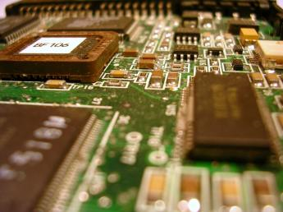
COE3062
Microcontrollers & Embedded Systems
Hardware Library for PIC
Dr Budditha Hettige
Department of Computer Engineering
General Sir John Kotelawala Defence University.

Slide 2
Hardware Library
LCD Library
ADC Library
Keypad Library
PS/2 Library

Slide 3
LCD Library
The mikroC PRO for PIC provides a library for communication with Lcds (with HD44780 compliant controllers) through the 4-bit interface.
For creating a set of custom Lcd characters use Lcd Custom Character Tool.
Library Routines
    Lcd_Init
    Lcd_Out // void Lcd_Out(char row, char column, char *text);
    Lcd_Out_Cp // void Lcd_Out_Cp(char *text);
    Lcd_Chr // void Lcd_Chr(char row, char column, char out_char);
    Lcd_Chr_Cp void Lcd_Chr_Cp(char out_char);Lcd_Cmd
    Lcd_Init // void Lcd_Cmd(char out_char);

Slide 4
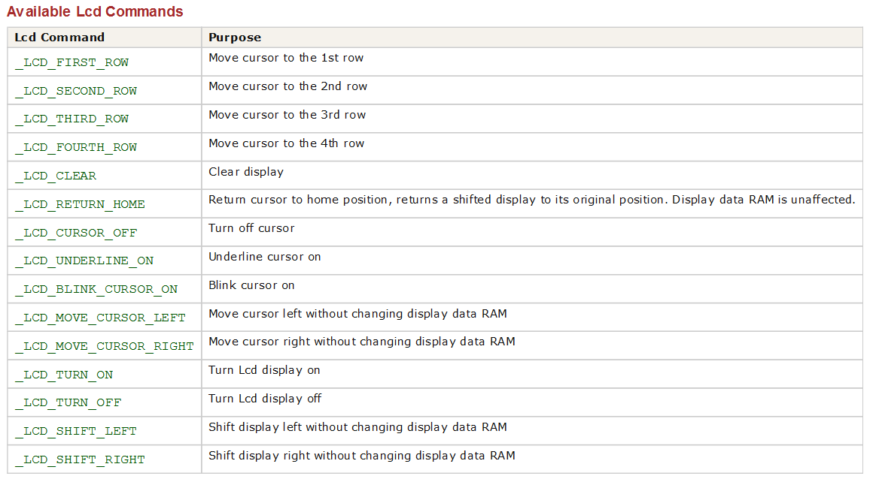
LCD Commands

Slide 5
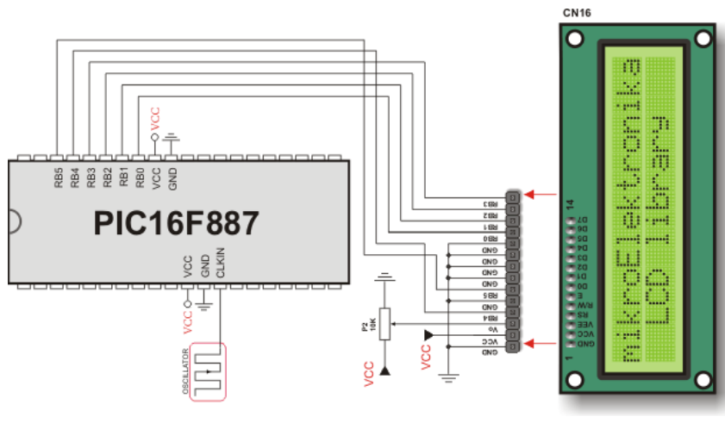
Diagram

Slide 6
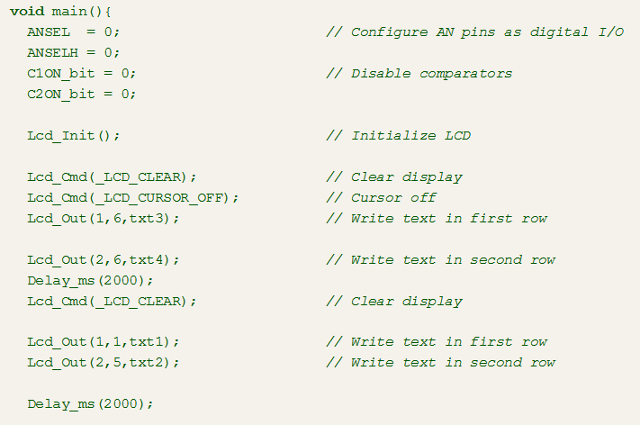
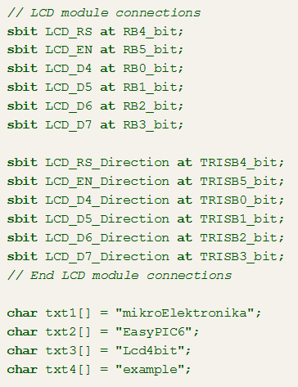
Code

Slide 7
ADC Library
ADC (Analog to Digital Converter) module is available with a number of PIC MCU modules.
ADC is an electronic circuit that converts continuous signals to discrete digital numbers.
ADC Library provides you a comfortable work with the module.
Library Routines
  ADC_Init
  ADC_Init_Advanced
  ADC_Get_Sample
  ADC_Read

Slide 8
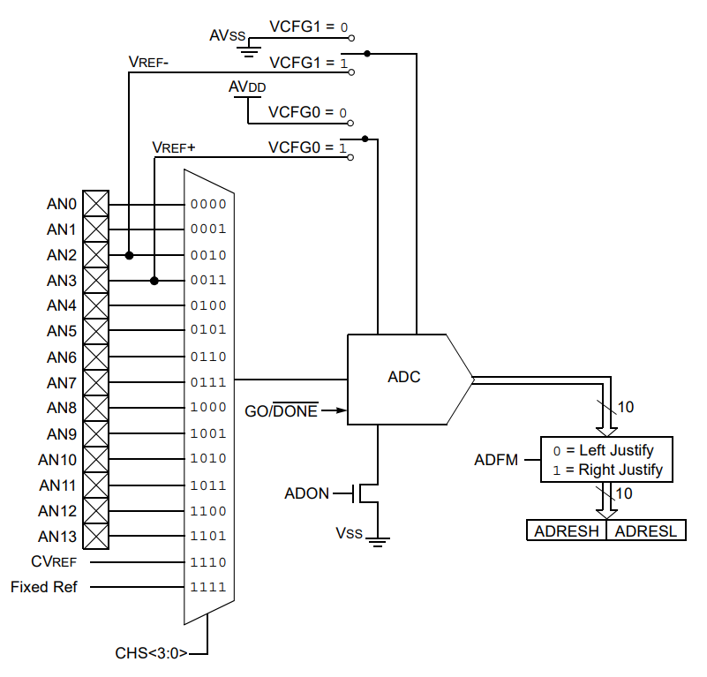
Block Diagram
More: PIC 16F887 Datasheet
9.0 ANALOG-TO-DIGITAL CONVERTER (ADC) MODULE

Slide 9
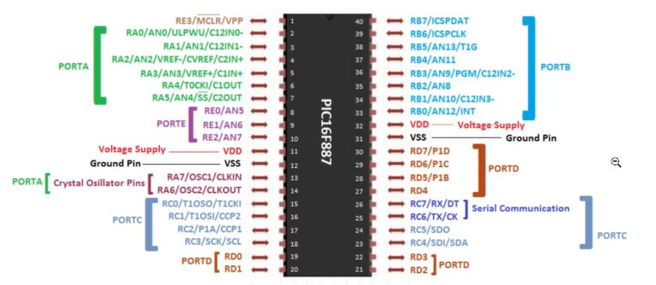
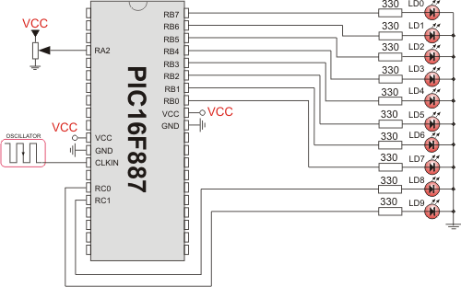
ADC Library

Slide 10
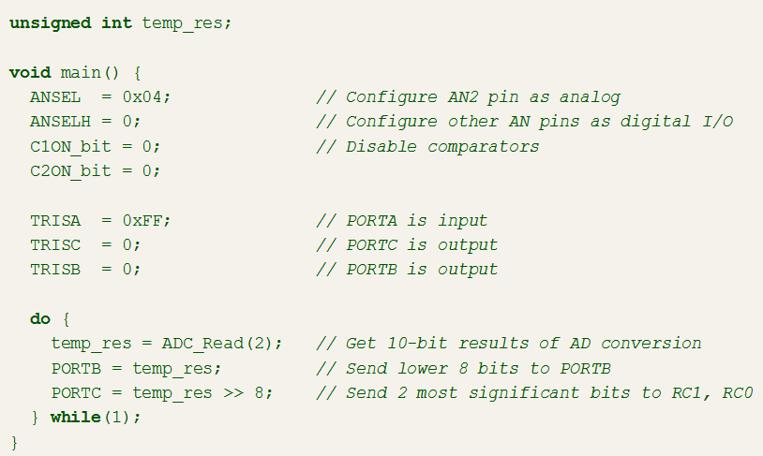
Code

Slide 11
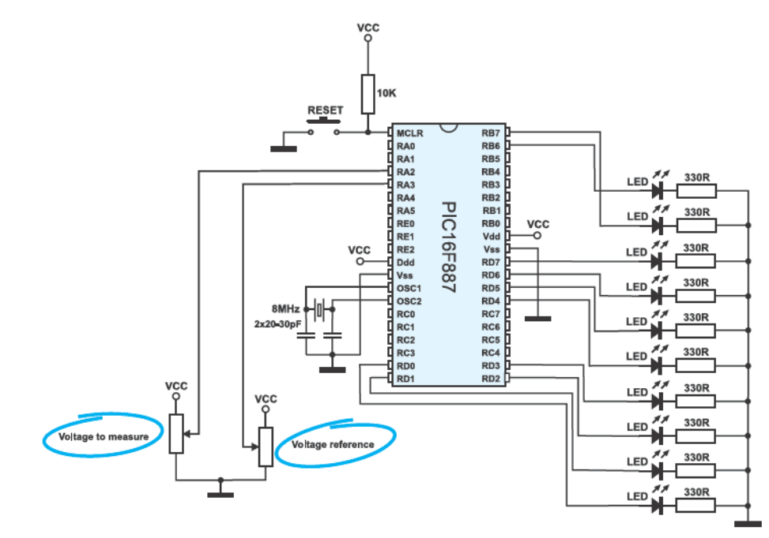
ADC with Voltage Control

Slide 12
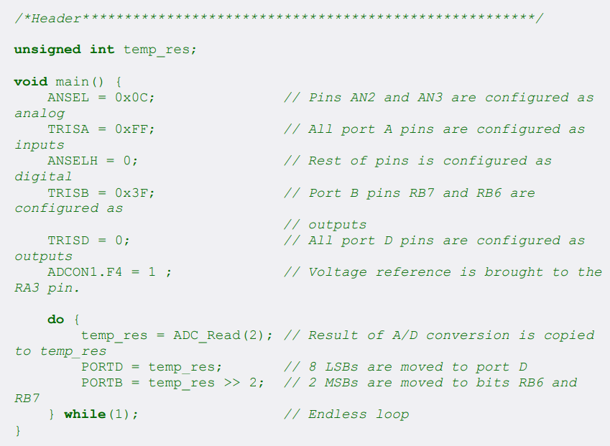
Code

Slide 13
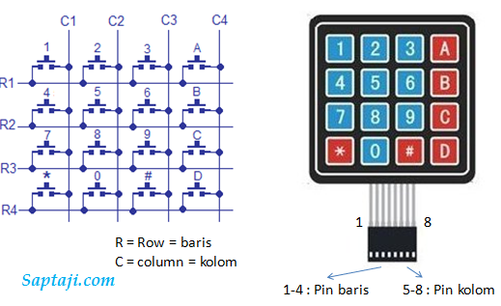
Keypad Library
The mikroC PRO for PIC provides a library for working with 4x4 keypad.
The library routines can also be used with 4x1, 4x2, or 4x3 keypad. For connections explanation see schematic at the bottom of this page.
Library Routines
  Keypad_Init
  Keypad_Key_Press
  Keypad_Key_Click

Slide 14
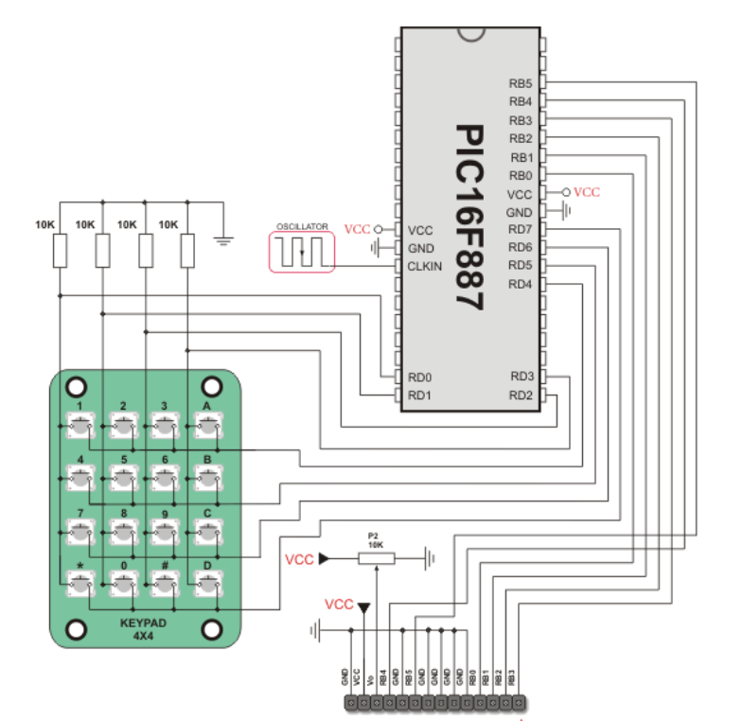
Diagram

Slide 15
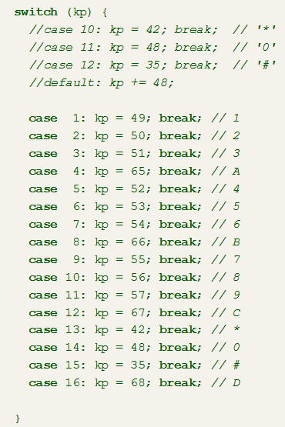
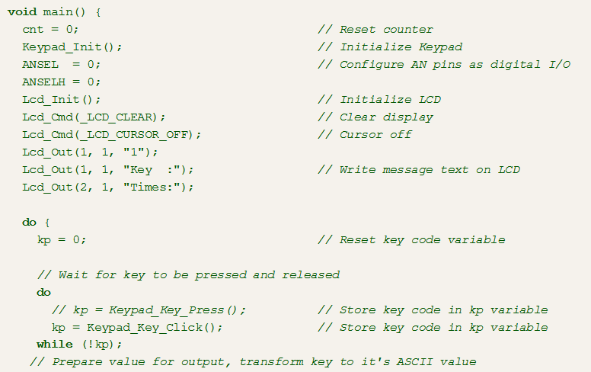
Code

Slide 16
PS/2 Library
The mikroC PRO for PIC provides a library for communication with the common PS/2 keyboard.
Important :
    The library does not utilize interrupts for data retrieval, and requires the oscillator clock to be at least 6MHz.
    The pins to which a PS/2 keyboard is attached should be connected to the pull-up resistors.
    Although PS/2 is a two-way communication bus, this library does not provide MCU-to-keyboard communication; e.g. pressing the Caps Lock key will not turn on the Caps Lock LED.
Library Routines
  Ps2_Config
  Ps2_Key_Read

Slide 17
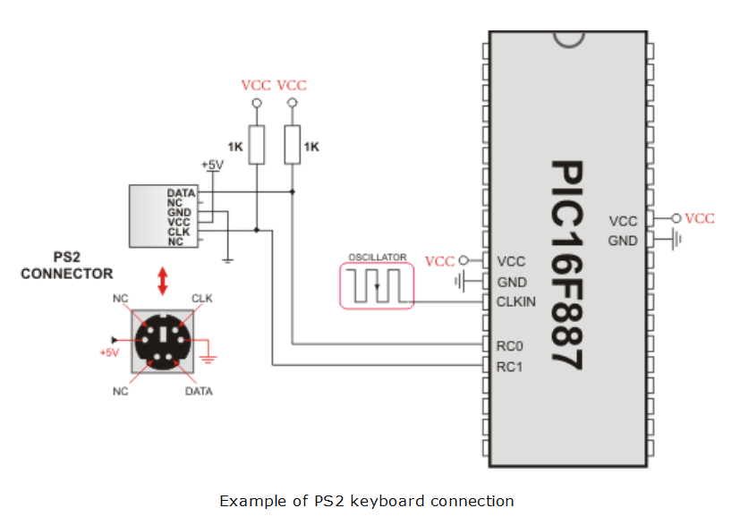
Diagram

Slide 18
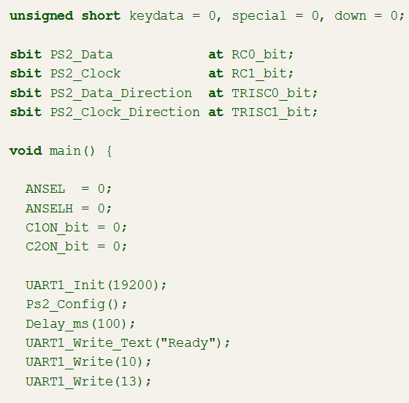
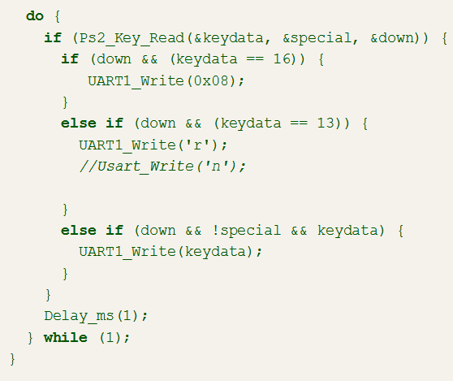
Code

Slide 19
UART Library
The UART hardware module is available with a number of PIC compliant MCUs.
The mikroC PRO for PIC UART Library provides comfortable work with the Asynchronous (full duplex) mode.
You can easily communicate with other devices via RS-232 protocol
Library Routines
    UARTx_Init
    UARTx_Data_Ready
    UARTx_Tx_Idle
    UARTx_Read
    UARTx_Read_Text
    UARTx_Write
    UARTx_Write_Text
    UART_Set_Active

Slide 20
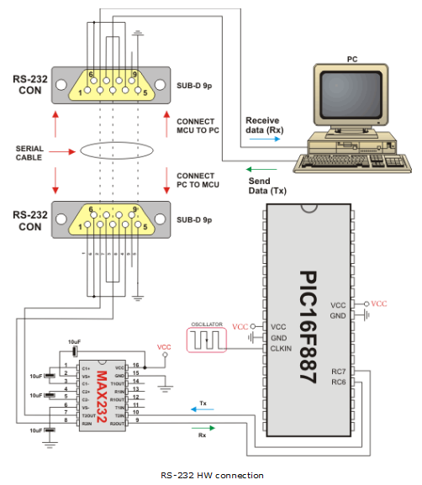
HW

Slide 21
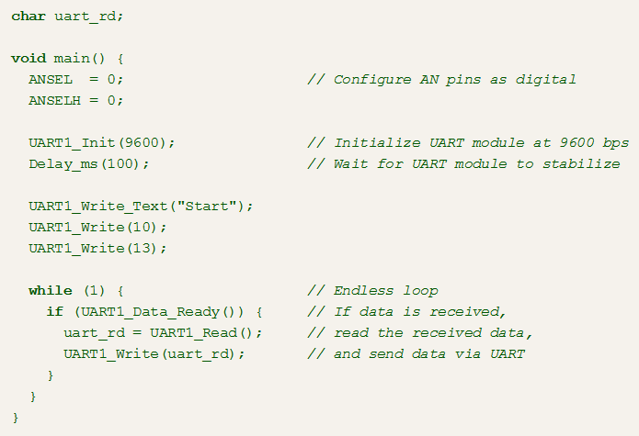
Code

Slide 22
I²C Library
The I²C full master MSSP module is available with a number of PIC MCU models.
mikroC PRO for PIC provides library which supports the master I²C mode.
Important :
  I²C routines require you to specify the module you want to use.
  To select the desired I²C, simply change the letter x in the prototype for a number from 1 to 2
Library Routines
I2Cx_Init I2Cx_Start
I2Cx_Repeated_Start I2Cx_Is_Idle
I2Cx_Rd I2Cx_Wr
I2Cx_Stop I2Cx_SetTimeoutCallback
I2C_Set_Active

Slide 23
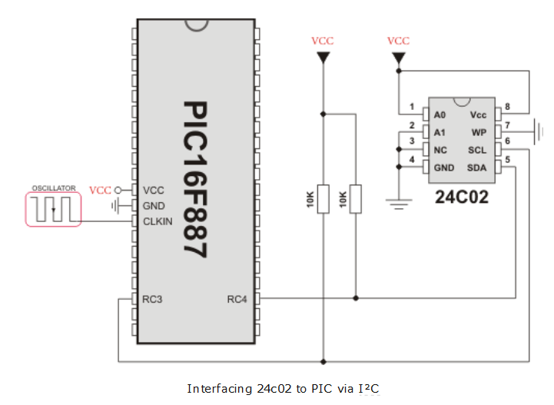
HW

Slide 24
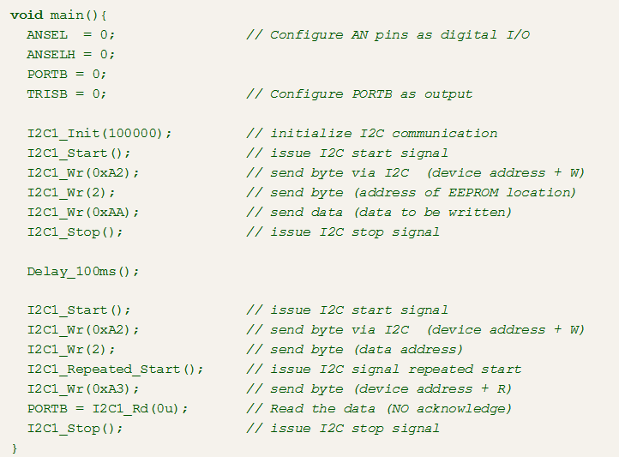
Code

